Slide 1
LECTURE 15
WILLIAM ALTON’S PERCEIVING GOD. THE EPISTEMOLOGY OF RELIGIOUS EXPERIENCE
CHAPTER 4

Slide 2
TWO DIFFERENT APPROACHES TO EPISTEMOLOGY
CONSERVATIVE COMMONSENSISM
(2) RADICAL RECONSTRUCTION

Slide 3
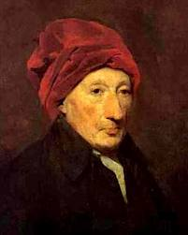
CONSERVATIVE COMMONSENSISTS
THOMAS REID
1710-1796

Slide 4
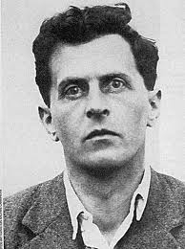
LUDWIG WITTGENSTEIN
1889-1951

Slide 5
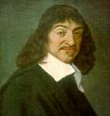
RADICAL RECONSTRUCTIONISTS
RENE “THE BEAK” DESCARTES

Slide 6
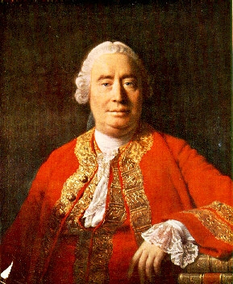
DAVID “FATSO” HUME
(1711-1776)

Slide 7
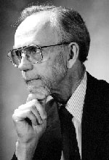
ALSTON IS A CONSERVATIVE COMMONSENIST

Slide 8
HOWEVER….
ALSTON WANTS TO ADD A “DOXASTIC PRACTICE” TO THE USUAL ACCEPTED SOURCES OF EVIDENCE. THE “ESTABLISHED” ONES ARE:
SENSE EXPERIENCE
(2) INTROSPECTION
(3) MEMORY
REASON
(5) TESTIMONY

Slide 9
ALSTON WANTS TO ADD:
MYSTICAL PERCEPTION.
HE HAS ALREADY ARGUED THAT IT IS ANALOGOUS TO SENSE PERCEPTION IN CERTAIN WAYS. THEN HE EXPLAINED HIS APPROACH TO EPISTEMOLOGY (EXTERNALIST, DIRECT REALIST, THE ROLE OF BELIEFS IN SENSE PERCEPTION

Slide 10
DOXASTIC PRACTICES
IN A CHAPTER (CHAPTER 3) WE DID NOT STUDY, ALSTON ARGUES THAT NO SOURCE OF TESTIMONY CAN BE SHOWN TO BE RELIABLE IN A NON-CIRCULAR WAY. EACH SOURCE OF KNOWLEDGE IS JUST ACCEPTED IF IT IS COHERENT, WELL ESTABLISHED, HAS A SYSTEM OF CHECKS AND BALANCES BUILT-IN, AND COHERES WITH OTHER SOURCES.

Slide 11
WE JUST FIND OURSELVES ACCEPTING DOXASTIC PRACTICES
WE CAN’T SHOW ANY OF THEM RELIABLE USING THEMSELVES (CIRCULAR) OR OTHERS – WHICH WOULD ULTIMATELY HAVE TO BE SHOWN RELIABLE USING OTHERS – PUSHING THE PROBLEM OF RELIABILITY BACK – OR USING ITSELF (CIRCULAR).

Slide 12
EXAMPLES OF EPISTEMIC CIRCULARITY
THE PROBLEM OF INDUCTION
THE PROOF OF THE EXISTENCE OF THE “EXTERNAL WORLD”
ATTEMPTS TO JUSTIFY LOGICAL TRUTHS, E.G. THE LAW OF NON-CONTRADICTION
CONCLUSION (OF THE CONSERVATIVES): WE JUST HAVE TO ACCEPT CERTAIN DOXASTIC PRACTICES

Slide 13
RADICAL RECONSTRUCTIONISTS
SOME SOURCES ARE BETTER THAN OTHERS. WE SHOULD BEGIN WITH THINGS THAT ARE ABSOLUTELY CERTAIN – E.G. THINGS THAT ARE CLEAR AND DISTINCT OR SENSE IMPRESSIONS – AND ATTEMPT TO RECONSTRUCT OR JUSTIFY THE OTHER SOURCES.
ALSTON THINKS THAT THESE PROJECTS FAIL.

Slide 14
OTHER PHILOSOPHERS HAVE AGREED
W. V. O. QUINE
OTTO NEURATH
CHARLES PEIRCE (A “CRITICAL COMMONSENIST”)

Slide 15
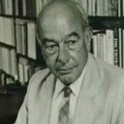
WILLARD VAN ORMAN QUINE

Slide 16

OTTO NEURATH

Slide 17

CHARLES PEIRCE

Slide 18
SO, BACK TO ALSTON
ALSTON ARGUES THAT THE CHRISTIAN MYSTICAL “PRACTICE” QUALIFIES AS A DOXASTIC PRACTICE. SO PEOPLE ARE PRIMA FACIE JUSTIFIED IN BELIEVING THAT MYSTICAL PERCEPTION PUTS THEM IN CONTACT WITH GOD.

